Slide 1
Chapter 5. The Natural and Step Response of RL and RC Circuits(2)

Slide 2
Contents
Natural Response of RC Circuits
Natural Response of RL Circuits

Slide 3
Goals
  Understanding and ability to find the natural response of first-order RC and RL circuits;

Slide 4
Contents
Natural Response of RC Circuits
Natural Response of RL Circuits

Slide 5
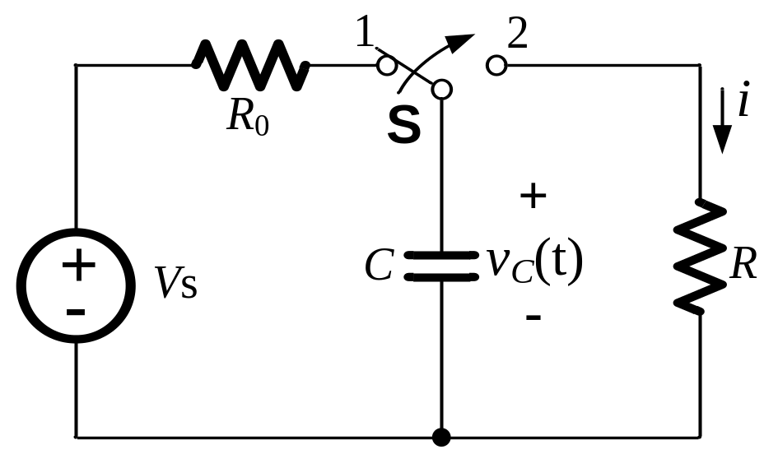
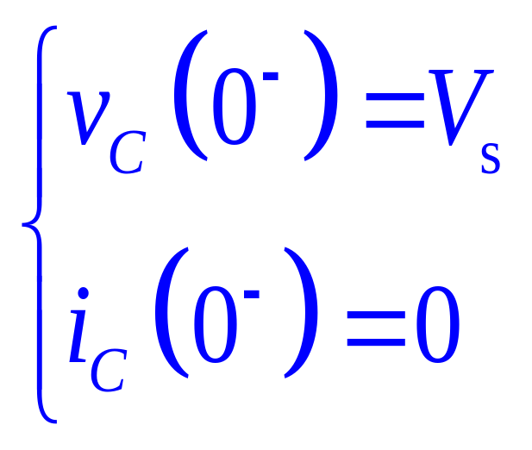
Natural Response of RC Circuits
The switch has been in the position 1 for a long time;
The switch is moved to 2 at t=0;
Energy stored in capacitor is suddenly released to R.

Slide 6
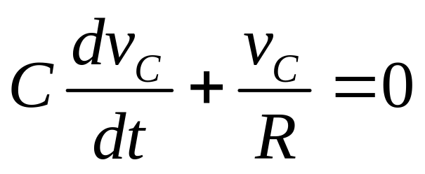
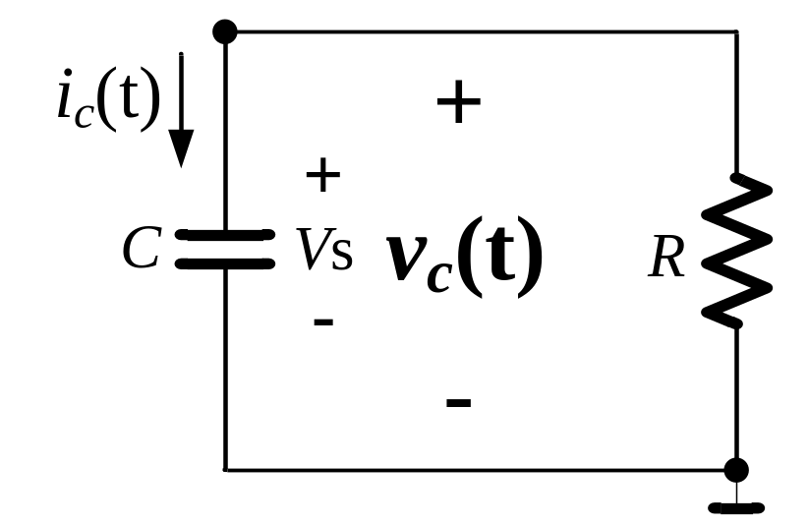
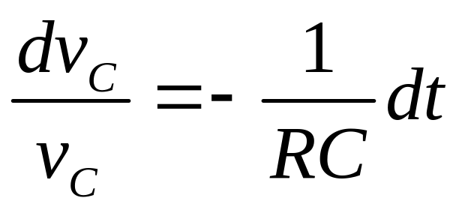
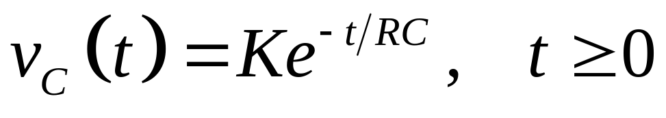
Natural Response of RC Circuits
By Node-Voltage method:
A

Slide 7
Contents
Natural Response of RC Circuits
Natural Response of RL Circuits

Slide 8
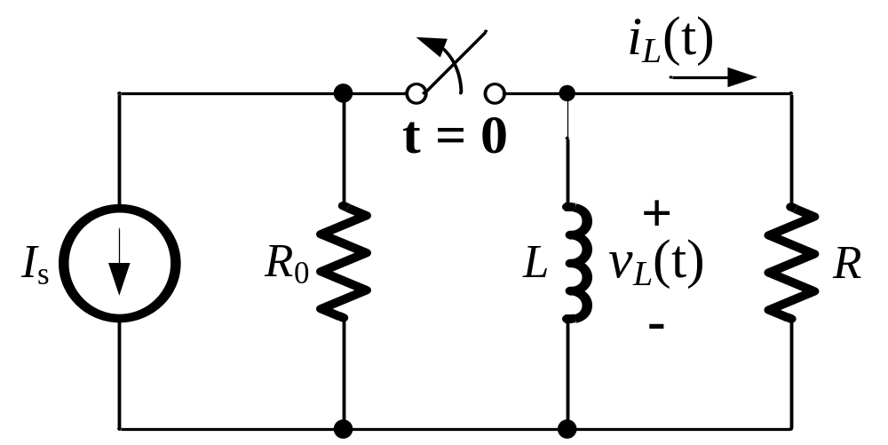
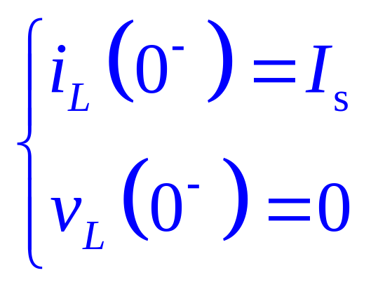
Natural Response of RL Circuits
The switch has been closed for a long time;
The switch is opened at the instant of t = 0;
Energy stored in L is suddenly released to R.

Slide 9
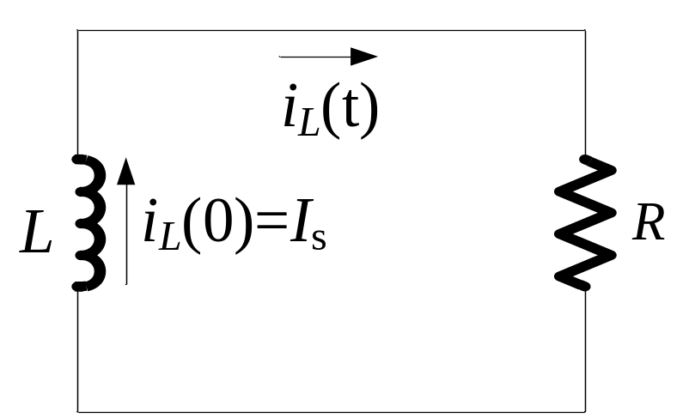
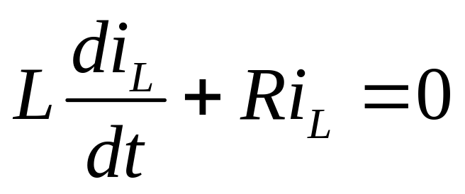

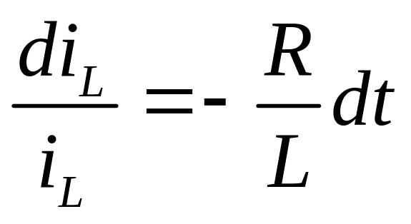
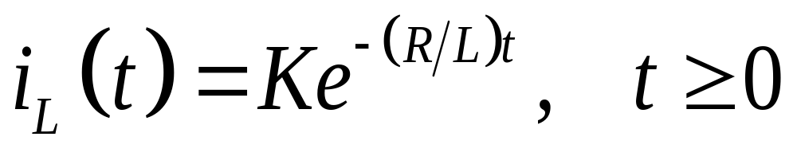
Natural Response of RL Circuits
By KVL for the loop:

Slide 10
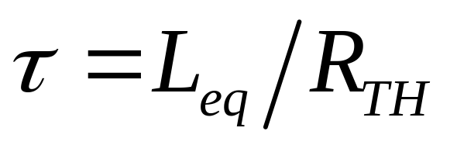
First-Order RL Circuit
R_{TH} is the Thévenin Equivalent resistance between the two terminals of the inductor;
L_{eq} is the equivalent inductance (If multiple inductors exist, they must be interconnected so that they must be replaced by a single equivalent inductor).

